Slide 1
Functional areas of human resource management
Dr Vibhav Singh

Slide 2
Functional areas of human resource management
RECRUITMENT AND STAFFING

Slide 3

Workforce/ HR Planning and Forecasting
The process of deciding what positions the firm will have to fill and how to fill them

Slide 4
Planning, recruitment & selection process
STEP 1
Planning for Recruitment & Selection
Job Analysis
Job description
Job specification
Human Resource Planning
STEP 2
Recruitment: Generating pool of candidates
Internal Sources
External Sources
STEP 3
Selection: Evaluation & Hiring
Employee testing for selection
Interviewing the candidate
Onboarding

Slide 5
Internal Source of candidates
Internal Recruiting is POPULAR
Essar has in-house initiative ‘Next-moves’
Advantages-
You know strengths and weakness of candidate
Candidate more committed to company
Moral rise
Requires less orientation
Disadvantages-
Rejected applicant may become disconnected
Waste of time
Immediate supervisor may not be behavior
Inbreeding (nepotism)
Internal recruiting resources
Succession management
Talent Inventory
Employee development
Internal Job Postings
Rehiring

Slide 6








Outside sources of candidates
Recruiting via Internet & Social Media
Most employers find that the Internet is their best choice for recruitment efforts.
Application filled through company’s website
Virtual office tour
Intelligent automated resume screening
Advantages- The Web is cost efficient, generating more responses more quickly and providing exposure for a longer time at less cost.
Disadvantages – Gathering applications online may exclude more mature applicants and certain minorities.

Slide 7

Outside sources of candidates
Advertising
The Media – The best medium should be selected based on the positions for which you are recruiting.
Times of India, EPW advertise
Local newspaper good source for local blue collar help, clerical roles
EA (Electronic Arts) includes information about internship program on backside of video game manual
Constructing (Writing) the Ad – Many experienced advertisers use a four-point guide called AIDA (attention, interest, desire, action) to construct their ads.

Slide 8
Outside sources of candidates
Employment Agencies
Public Agencies-
In India, every state has a public, state run employment agency
At the national level, employment exchange run by DG of employment and training, GoI
Employment Exchange act (1959) government companies and eligible private firm need to notify vacancies to the exchange
employment exchange also provide helpline for job search
Mixed experience with employment exchange:
People who are not interested to work are also registered and sometimes get hired causing problem to employers
Employment exchange struggle to find suitable jobs & have lost credibility

Slide 9
Outside sources of candidates
Temporary worker & Alternate Staffing
Trend to hire them- weak economic confidence among employers, Short-term project, they provide flexibility
India, lack legal flexibility with regular employees so companies prefer contractual labor
It can be done through (a) direct hiring (USA) (b) Temp Agency (India)
Offshoring/Outsourcing Jobs
Special Challenges- (a) cultural misunderstanding (b) Security and information privacy concern (c) Liability and legal system (d) bringing ‘jobs back’
Executive Recruiters
Executive recruiters, also called headhunters, are special employment agencies retained by employers to seek out top-management talent for their clients.
Pros and Cons – Recruiters can be useful and save a manager’s time, but they may be more interested in persuading managers to hire a candidate than in finding one who will really do the job.
Guidelines – Make sure the recruiting firm is capable, meet the individual who will handle the assignment, and ask how much the firm charges. Never rely on the recruiter to do all the reference

Slide 10
Why employee selection is important
Aim of employee selection
Person-Job Fit
Person- Organization fit
Matching the KSACs of the candidate with job requirements
To see whether candidate is culturally fit from long-term perspective
Candidate may be right for job but not for organization

Slide 11
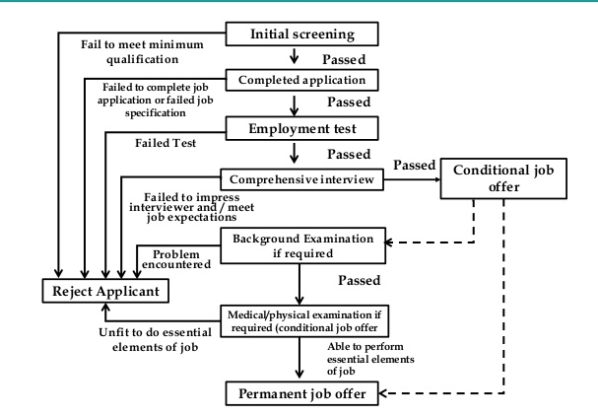
Selection process

Slide 12
Selection methods
INTERVIEW
PERSONALITY PROFILING
ONLINE SCREENING
PSYCHOMETRIC TESTING
APTITUDE TEST

Slide 13
Screening methods
Screening Methods
Resumes and cover letters
weighted application blanks
Biographical information
Telephone screens

Slide 14
Functional areas of human resource management
TRAINING AND DEVELOPMENT

Slide 15
TRAINING AND DEVELOPMENT

Slide 16
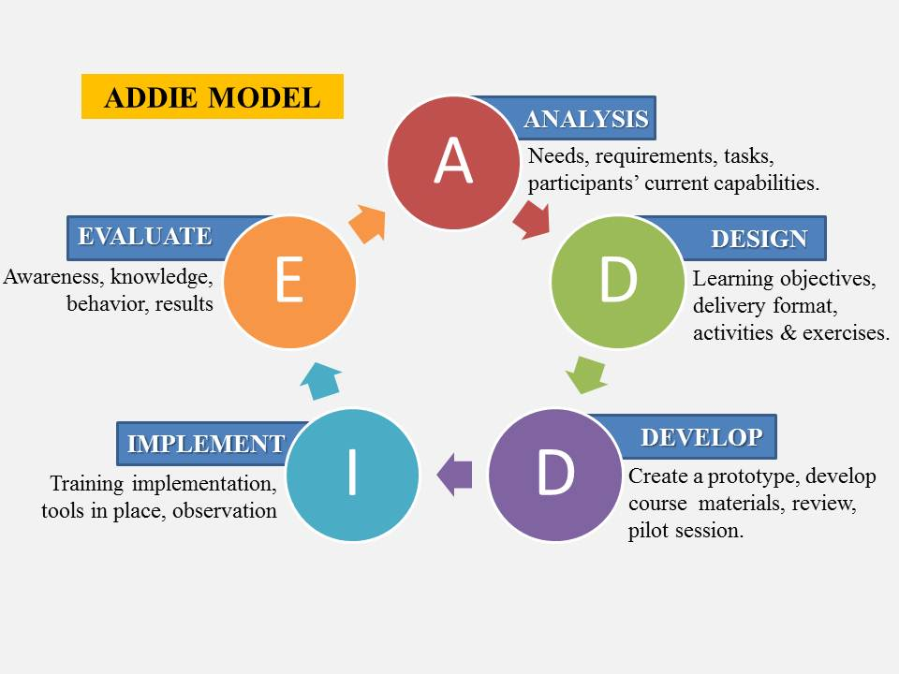
Training process

Slide 17
Conducting the training need analysis
Current training need analysis
Most of the training aims at improving current performance- specially new employees & those whose performance is deficient.
New employees
To determine what the job entails and to break it down into subtasks, and then assess
Current employees
Training needs are more complex – is training the real solution

Slide 18
Conducting the training need analysis
Task analysis: analyzing new employees’ training needs
At the lower level, you hire inexperienced and train them in comparison to higher level.
Task analysis is a detailed study of job to determine what specific skills- Java (web developer).
For task analysis, job description and job specification is required

Slide 19
Conducting the training need analysis
Performance analysis: analyzing current employees’ training needs
Performance analysis is the process of verifying that there is a performance deficiency and determining whether the employer should correct such deficiencies through training or some other means.
Performance appraisal.
Can’t do/ won’t do
The biggest issue is to figure out what is causing the lower performance. If the problem is employee motivation then training is unlikely to fix this.

Slide 20
Designing training program
1. Setting learning objectives
2. Creating a motivational learning environment
3.Make the Learning Meaningful
Bird’s-eye view to participants
Familiar examples/terms
Organize the content
Perceived need
4. Making Skills Transfer Obvious and Easy
Similarity
Practice
Attention to important aspect of the job
“Heads-up”
Trainee’s learn at their own pace
5.Reinforce The Learning
Reinforce correct responses
Partial day training
Follow-up assignments
Incentivize

Slide 21
Designing training program
Ensure transfer of learning to the job
Prior to training- get trainee and supervisor input in designing the program, institute a training attendance policy, and encourage employees to participate
During training-, provide trainees with training experiences and conditions (surroundings, equipment) that resemble the actual work environment
After training -reinforce what trainees learned

Slide 22
Implement training program
On-the-job training (OJT)
Having a person learn a job by actually doing it.
Types of OJT
Coaching or understudy method- experienced supervisor trains the employee
Job rotation- employee moves from one job to another at planned intervals
Peer training – radio program, experienced employees answer queries of other employees

Slide 23
Implement training program
Apprenticeship Training
Apprenticeship training is a process by which people become skilled workers,usually through a combination of formal learning and long-term on-the-job training
involves having the learner/apprentice study under the tutelage of a master craftsperson.
Informal Learning
As much as 80% of what employees learn is through informal means
Cheesecake Factory, the restaurant chain allows employees to create, upload and share video clips on job-related topics through a portal called Video Cafe.
Job Instruction Training
Listing each job’s basic tasks, along with key points, in order to provide step-by-step training for employees

Slide 24
Implement training program
Lectures
Lecturing is a quick and simple way to present knowledge to large group of trainees
Programmed Learning
Systematic method for teaching job skills, involving presenting questions or facts
Allowing the person to responds
Giving the learner immediate feedback on the accuracy of his or her answers.

Slide 25
Implement training program
Behavior Modeling
Bobo doll (video)
Behavior modeling involves
(1) showing trainees the right (or “model”) way of doing something,
(2) letting trainees practice that way, and then
(3) giving feedback on the trainees’ performance.
Sales skills
Interviewer skills
Modeling
Role Playing
Social reinforcement
Transfer of training

Slide 26
Implement training program
Audiovisual-based Training
Audio- videotapes used to train. The ford Motor company uses videos in its dealer training session to simulate problems and reactions to various customer complaints.
Vestibule Training
When it is too costly or dangerous to train employees on the job. Indian Banks train new entrant through dummy banks
Videoconferencing (Video)
Videoconferencing is popular for training geographically dispersed employees. It involves delivering programs via compressed audio and video signals over cable broadband lines, the Internet, or satellite. CISCO offers training through videoconference on Webex, telepresence
Simulated Learning (Video)
virtual reality-type games with a step-by-step animated guide, and online role-play with photos and videos. In general, interactive and simulated technologies reduce learning time by an average of 50%.

Slide 27
The Kirkpatrick Model
Level 4: Results
Level 3: Behavior
Level 2: Learning
Level 1: Reaction

Slide 28
Functional areas of human resource management
COMPENSATION

Slide 29

COMPENSATION
Direct Financial Payments
Pay in the form of wages, salaries, incentives, commissions, and bonuses.
Indirect Financial Payments
Pay in the form of financial benefits such as insurance.

Slide 30
Basic factors in determining pay rates
Aligning total rewards with strategy
The basic thrust in pay plans today is to produce an aligned reward strategy
To create compensation plans that guide employee behaviors in the desired, strategic direction
Total rewards include traditional pay, incentives, and benefits. It also includes challenging jobs, career development, and recognition programs.

Slide 31
Establishing Strategic Pay Plan-
Job evaluation
Market-based Pay Plan
Executive Compensation
Competency Pay Plan
Pay for Performance-
Individual employee incentive and recognition programs
Incentives for Sales People
Team and Organization wide incentives
Benefits and Services-

Slide 32
Establishing Pay rates
Market Based approaches
Job evaluation methods
Employers use two basic approaches to setting pay rates

Slide 33
The Benefits Picture
Policy Issues- The list of policy issues includes what benefits to offer.
who receives coverage,
whether to include retirees in the plan,
whether to deny benefits to employees during initial “probationary” periods
how to finance benefits, cost-containment procedures, and how to communicate benefits options to employees.
Benefits are indirect financial and nonfinancial payments

Slide 34
Vacations and Holidays
Sick Leave
Cost-Reduction Tactics
Leaves and the Family, and medical Leave Legislation
Severance Pay
Hospitalization, health, and disability insurance benefits are aimed at
Pension Plans
Family-friendly (work–life) benefits
The cafeteria approach

Slide 35
Functional areas of human resource management
EMPLOYEE RELATIONS

Slide 36
Managing Employee Relations
What Is Employee Relations?
Positive employee–employer relationships contribute to productivity
Improving and assessing employee relations through better communications
Organizational climate surveys
Distributive justice and Procedural Jutsice
Notes:
Individual supervisors can of course use methods such as open-door policies and “management by walking
around” to informally monitor “how things are going.” Other employers use surveys, newsletters, and staff
meetings to facilitate communications. The owner of 11 IHOP restaurants reduced its employee turnover
with an online survey.
Employee attitude, morale, or climate surveys play a part in many firms’ employee relations efforts. They
use the surveys to “take the pulse” of their employees’ attitudes toward a variety of organizational issues
including leadership, safety, role clarity, fairness, and pay, and to thereby get a sense of whether their
employee relations need improvement.

Slide 37
Managing Employee Relations
Developing Employee Recognition/Relations Programs
Creating Employee Involvement Strategies
Teams to gain employees’ involvement
Employee suggestions
Notes:
Instituting recognition and service award programs requires some planning and a budget. For example,
selecting awards, having a procedure for monitoring what awards to actually award, having a
process for giving awards (such as special dinners or staff meetings), and periodically assessing
program success. Similarly, instituting a recognition program requires developing criteria for
recognition (such as customer service, cost savings, etc.), creating forms and procedures for
submitting and reviewing nominations, selecting meaningful recognition awards, and establishing a
process for actually awarding the recognition awards.
Employee relations tend to improve when employees get involved with the company in positive
ways, and so employee involvement is another useful employee relations strategy.
Employers also use various types of teams to gain employees’ involvement in addressing organizational
issues. Suggestion teams are temporary teams whose members work on specific analytical assignments,
such as how to cut costs or raise productivity.
A quality circle is a special type of formal problem-solving team, usually composed of 6 to 12 specially
trained employees who meet weekly to solve problems affecting their work area.
A self-managing/self-directed work team is “a highly trained group of around eight employees, fully
responsible for turning out a well-defined segment of finished work.”
Employers understand that employee suggestions can produce significant savings and employees find
it involving to make suggestions.

Slide 38
Trade unions
Why do people unionize?
It’s majorly about pay or working conditions.
In India, unionized workers in the formal sector earn more than their counterparts in the informal sector
Bottom Line
The urge to unionize due to the belief on the part of workers that it is only through unity that they can get their fair share of the pie.
It is sometimes the result of workers trying to protect themselves from management’s whims.
Union workers tend to receive significantly more pay, holidays, sick leave, unpaid leave, insurance plan benefits, long-term disability benefits, and various other benefits than do nonunion workers.
Unions seem to have reduced the impact of downsizings and wage cuts in most industries, in part because union employees are not entirely “at will.”

Slide 39
India’s union movement
India’s labour movement is more than 150 years old
It gained its momentum in 1918 when Madras labour union was formed with mill workers as members
The focus of the unions was to end exploitations of workers in factories
Trade unions participated in freedom struggle
Trade unions in India are often influenced by political parties and elected governments
Emergency in 1975 led to suspensions of Trade unions
At the first wave of partial economic liberalization 1984 led to change in orientation, linking productivity with agreements.

Slide 40
India’s union movement
The next phase of economic reforms introduced in 1992- VRS, National renewal fund (to adjust economic realities)
IT sector approach unionization.

Slide 41
The Collective Bargaining Process
To bargain collectively is a mutual obligation to meet at reasonable times and confer in good faith with respect to wages, hours, terms and conditions of employment, the negotiation of an agreement, and other related matters.
Good faith bargaining means that both parties communicate and negotiate, that they match proposals with counterproposals, and that both make every reasonable effort to arrive at an agreement. A violation of the requirement for good faith bargaining may include the following: surface bargaining, inadequate concessions, and inadequate proposals and demands.

Slide 42
Dealing with Disputes and Grievances
Employees may use just about any factor involving wages, hours, or conditions of employment as the basis of a grievance. The grievance procedure is specified in most collective bargaining contracts. It specifies the various steps in the procedure, time limits, and specific rules.
Examples of guidelines for handling grievances include investigating and handling each and every one of the grievances filed, talk with the employee and require the union to identify specific contractual provisions allegedly violated. Don’t discuss the case with the union steward alone – the grievant should be there. Don’t make arrangements with individual employees. Don’t hold back the remedy if the company is wrong and don’t admit the binding effect of a past practice.

Slide 43
Safety and the Manager
Why safety is important
The hidden story
Management’s role in safety
What top management can do
The supervisor’s role in
safety
Occupational Health and Safety in India
List of important Indian legislations covering Safety and Health, and the administrative mechanisms –
The Factories Act of 1948
The Mines Act, 1952
The Dock Workers (Safety, Health and Welfare) Act, 1986

Slide 44
Occupational Safety Law - India
The Contract Labour (Regulation and Abolition) Act, 1970
The Workmen’s Compensation Act, 1923
Employees Sate Insurance Act (ESI Act) 1948
Firm level Safety Management: Safety Officers and Committees

Slide 45
What Causes Accidents?
There are three basic causes of workplace accidents: chance occurrences, unsafe conditions, and employees’ unsafe acts. Unsafe conditions are a main cause of accidents. They include:
Improperly guarded or defective equipment
Hazardous procedures
Unsafe storage
Improper illumination or ventilation

Slide 46
Occupational Security and Safety
Preventing and Dealing with Violence at Work
Security measures
Employee screening
Supervisory training
Violence toward women
Notes:
Risk Management Magazine estimates that about 86% of past workplace violence incidents
were anticipated by coworkers, who had brought them to management’s attention prior to
the incidents actually occurring. Yet management usually did little or nothing. Human resource
managers can take several steps to reduce the incidence of workplace violence:
Heightened security measures are the first line of defense, whether the violence derives from
coworkers, customers, or outsiders. According to OSHA, measures should include those in
Figure 16-8:
• Improve external lighting.
• Use drop safes to minimize cash on hand.
• Post signs noting that only a limited amount of cash is on hand.
• Install silent alarms and surveillance cameras.
• Increase the number of staff on duty.
• Provide staff training in conflict resolution and nonviolent response.
• Close establishments during high-risk hours late at night and early in the morning.
• Issue a weapons policy; for instance, “firearms or other dangerous or deadly weapons
cannot be brought onto the facility either openly or concealed.”
With about 30% of workplace attacks committed by coworkers, screening out potentially
violent applicants is the employer’s next line of defense. Personal and situational factors
correlate with workplace aggression. Men, and individuals scoring higher on “trait anger”
(the predisposition to respond to situations with hostility), are more likely to exhibit
workplace aggression.
Train supervisors to identify the clues that typify potentially violent current employees.
Common clues include:
● An act of violence on or off the job
● Erratic behavior evidencing a loss of perception or awareness of actions
● Overly confrontational or antisocial behavior
● Sexually aggressive behavior
● Isolationist or loner tendencies
● Insubordinate behavior with a threat of violence
● Tendency to overreact to criticism
● Exaggerated interest in war, guns, violence, mass murders, catastrophes, and so on
● Commission of a serious breach of security
● Possession of weapons, guns, knives, or like items in the workplace
● Violation of privacy rights of others, such as searching desks or stalking
● Chronic complaining and the raising of frequent, unreasonable grievances
● A retributory or get-even attitude
The proportion of women who are victims of assault is much higher then for men. Women
(and men) should have access to domestic crisis hotlines, such as www.womenshealth.gov/
violence-against-women/ get-help-for-violence/violence-help-hotlines.html, and to employee
assistance programs.

Slide 47
Occupational Security and Safety
Setting Up a Basic Security Program
Analyze current level of risk
Installing mechanical
Natural and
Organizational security systems
Notes:
Security programs ideally start with an analysis of the facility’s current level of risk. Many organizations establish cross-functional threat assessment teams.
As part of this initial threat assessment, also review these six matters:
1. Reception area access, including need for a “panic button”;
2. Interior security, including secure restrooms, and better identification
of exits;
3. Authorities’ involvement, in particular emergency procedures developed
with local law enforcement;
4. Mail handling, including screening and opening mail;
5. Evacuation, including evacuation procedures and training; and
6. Backup systems, such storing data off site.
Having assessed the potential current level of risk, the employer then turns its attention to assessing and improving natural, mechanical, and organizational security.
Natural security means capitalizing on the facility’s natural or architectural features to minimize security problems. For example, do too many entrances hamper controlling facility access?
Mechanical security is the utilization of security systems such as locks, intrusion alarms, access control systems, and surveillance systems to reduce the need for continuous human surveillance.
Finally, organizational security means using good management to improve security. For example, it means properly training and motivating security staff and lobby attendants. Similarly, ensure that the security staff has written orders that define their duties, especially in situations such as fire, elevator entrapment, hazardous materials spills, medical emergencies, hostile intrusions, suspicious packages, civil disturbances, and workplace violence.

Slide 48
Functional areas of human resource management
HRIS

Slide 49
HRIS
What is HRIS
It is a systematic way of storing data & information for each individual employee to aid planning, decision making & submitting of returns and reports to the external agencies. A method by which an organization collects, analyses & reports the information about people and job.
Objectives of HRIS
To offer sufficient, comprehensive & ongoing information about people & jobs.To supply up to date information at a reasonable cost.To offer data security & personal privacy.

Slide 50
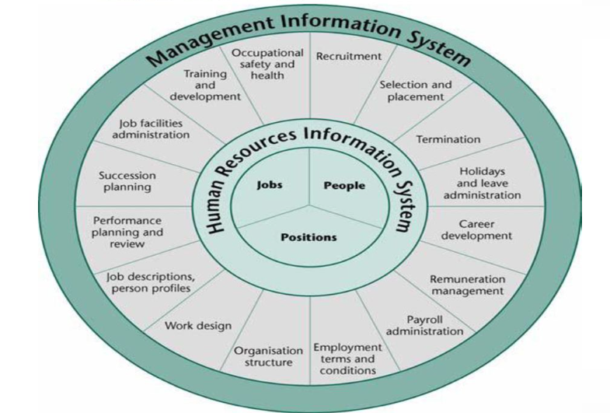

Slide 51
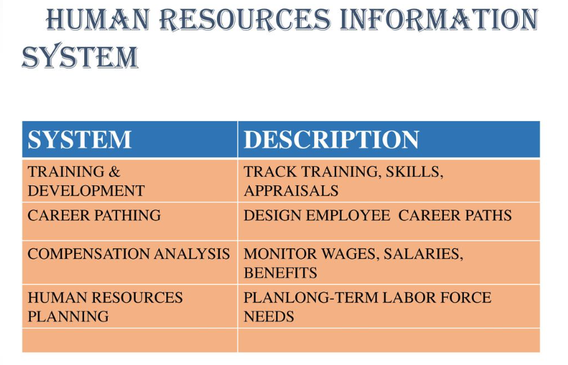

Slide 52
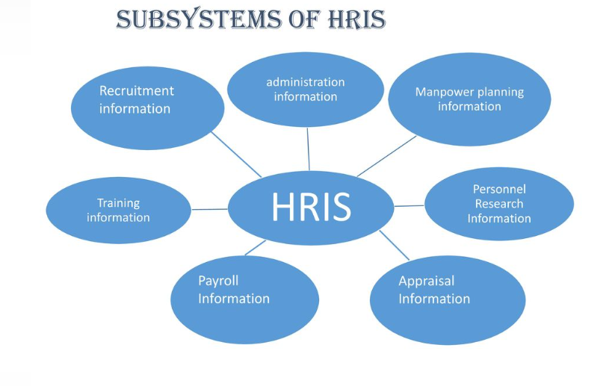

Slide 53
Functional areas of human resource management
ORGANIZATION DESIGN

Slide 54
Seven Elements of an Organization’s Structure
The Key Question | The Answer Is Provided by
1. To what degree are activities subdivided into separate jobs? | Work specialization
2. On what basis will jobs be grouped together? | Departmentalization
3. To whom do individuals and groups report? | Chain of command
4. How many individuals can a manager efficiently and effectively direct? | Span of control
5. Where does decision-making authority lie? | Centralization and decentralization
6. To what degree will there be rules and regulations to direct employees and managers? | Formalization
7. Do individuals from different areas need to regularly interact? | Boundary spanning

Slide 55
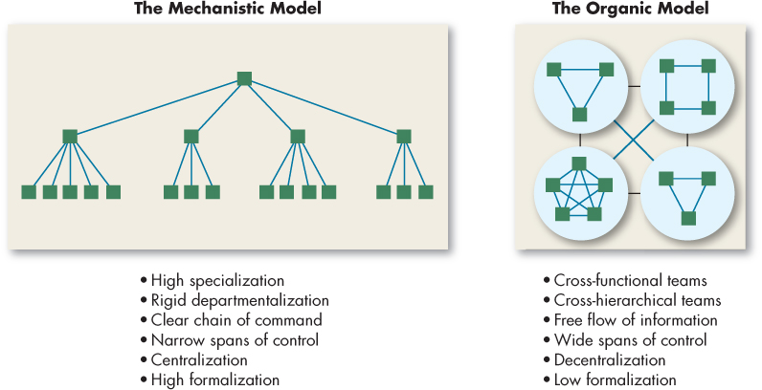
Mechanistic vs. Organic Structural Models
Exhibit 15-7 Mechanistic versus Organic Models
Notes:
We’ve described organizational designs ranging from the highly structured bureaucracy to the amorphous boundaryless organization. There are also two extreme models of organizational design, as seen here in Exhibit 15-7.
First, the mechanistic model is synonymous with bureaucracy and has extensive departmentalization, high formalization, a limited information network (mostly downward), and little participation in decision making. The organic model uses cross-hierarchical and cross-functional teams, low formalization, a comprehensive information network, and high participation in decision making.
Why are some organizations structured along mechanistic lines while others are organic? In this section, we present the major causes or determinants of an organization’s structure.

Slide 56
New design- Team Structure
In an organizational structure based on teams, the structure breaks down department barriers and decentralizes decision making to the level of the team.
Team structures usually require employees to be generalists as well as specialists.

Slide 57
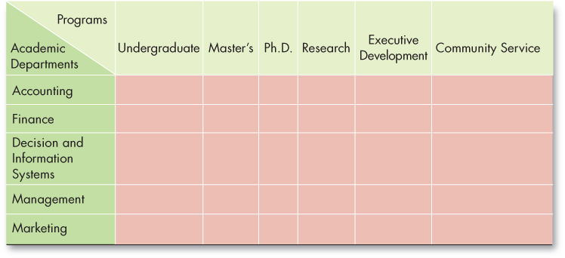
Common Organizational Frameworks and Structures
The matrix structure combines two forms of departmentalization—functional and product:
The strength of functional is putting specialists together.
Product departmentalization facilitates coordination.
It provides clear responsibility for all activities related to a product, but with duplication of activities and costs.

Slide 58
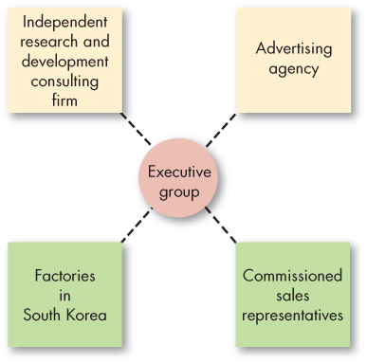
Alternate Design Options
The Virtual Organization
The essence of the virtual organization is that it is typically a small, core organization that outsources major business functions.
Also referred to as a modular or network organization.
It is highly centralized, with little or no departmentalization.

